Slide 1
Multi-Agent
Programming
Mentor : Mr. Kishore Kumar Yaramshetty
by :
Chinmay Phutela - 13103467
Shubham Kumar Jain - 13103481

Slide 2
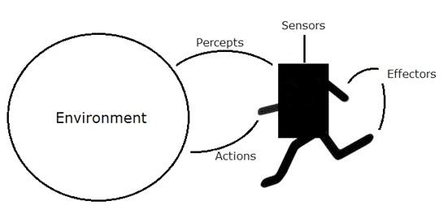
An agent is anything that can perceive its environment through sensors and acts upon that environment through effectors.
A human agent has sensory organs such as eyes, ears, nose, tongue and skin parallel to the sensors, and other organs such as hands, legs, mouth, for effectors.
A robotic agent replaces cameras and infrared range finders for the sensors, and various motors and actuators for effectors.
A software agent has encoded bit strings as its programs and actions.

Slide 3
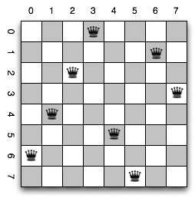
What is N-Queen problem?
The N Queen is the problem of placing N chess queens on an N×N chessboard so that no two queens attack each other.
For example, following is a solution for 8 Queen Problem.

Slide 4
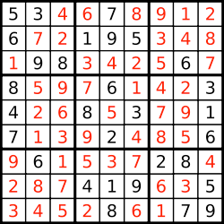
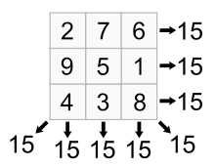
Applications
Sudoku Solver
Magic Squares

Slide 5
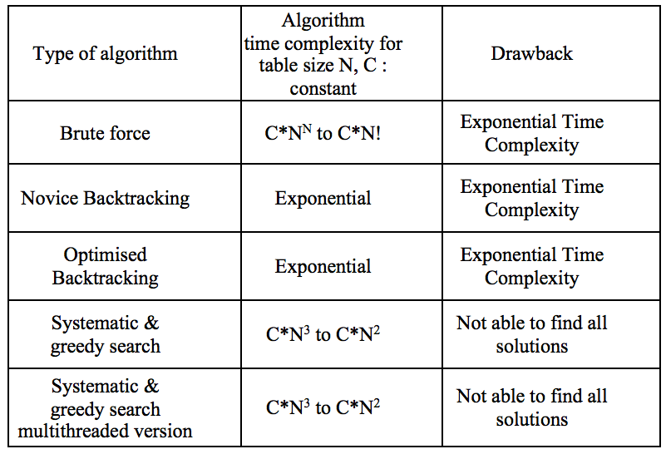
Current Approaches & Drawbacks

Slide 6
What is
Agent Programming?

Slide 7
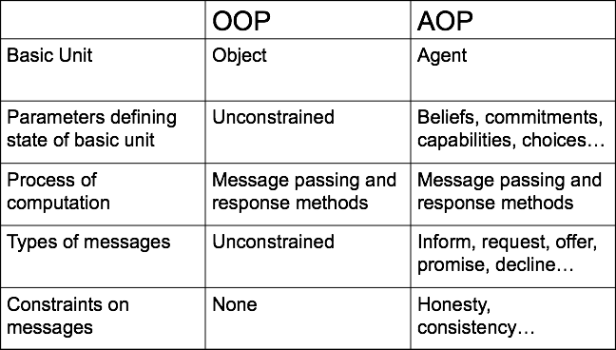
Agent-oriented programming (AOP) is a programming paradigm where the construction of the software is centered on the concept of software agents. In contrast to object-oriented programming which has objects at its core, AOP has externally specified agents at its core.

Slide 8


Applications
Agent Programming, being a subset of Artificial Intelligence has many real-life applications such as:

Slide 9
Introducing 2APL -
A Practical Agent Programming Language
2APL is a BDI-based agent-oriented programming language that supports an effective integration of multi-agent system programming constructs such as belief and goals and imperative style programming constructs such as events and plans.
Agents hosted on different 2APL platforms can communicate with each other. 2APL interpreter is built on the JADE platform.

Slide 10
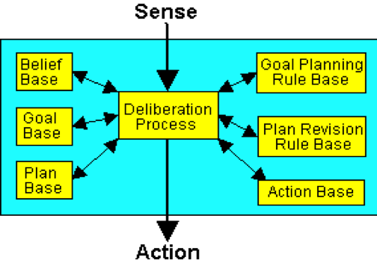
2APL Architecture

Slide 11



2APL Modules
Belief Base -
Implemented by a subset of first-order predicate language (prolog like facts and rules)
Goal Base -
Implemented by expressions of an imperative language ( procedural or to-do goals)
Plan Base -
Built from basic actions composed through program operators sequential “;”, iteration “while-do”, conditional “if-then-else”

Slide 12
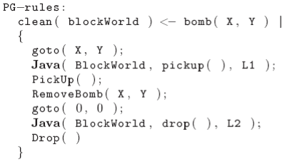
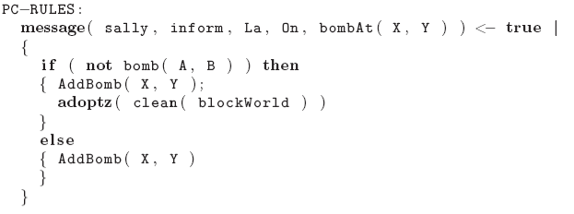
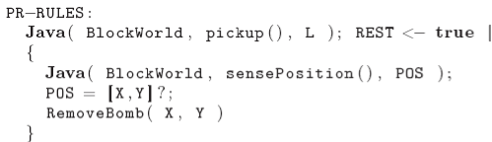
Action Base -
Implemented as triplets consisting of action name together with pre-condition (under which action can be performed) and post-conditions (effect of the action after it’s performed)
Goal Plan Rules -
Revision blocked actions, not achievable goals, generation/optimize goals
Plan Revision Rules – Used to revise, adopt, and drop plans
Interpreter - Implementing the Deliberation process. Applying reasoning rules, selecting goals and actions

Slide 13
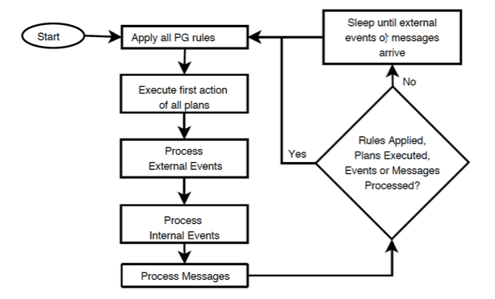
2APL Deliberation Cycle

Slide 14
Thank You

